Slide 1


TELEMATICS CONTROL UNIT IN MODERN VEHICLES

Slide 2


Team members
Ahmed sherif
Communication Department
Ahmed abdellah
Mariam mostafa
Nada mohamed
Content
Department
Samaa khaled

Slide 3

our sponsors & mentors
supervised by:
DR: Mohamed Eldakrory
Mentored by:
ENG:Bishoy Wasfy
ENG:Bahaa sehsah

Slide 4
introduction
Automotive dead reckoning
Emergency call system
Socket programming
Inter process communication

Slide 5
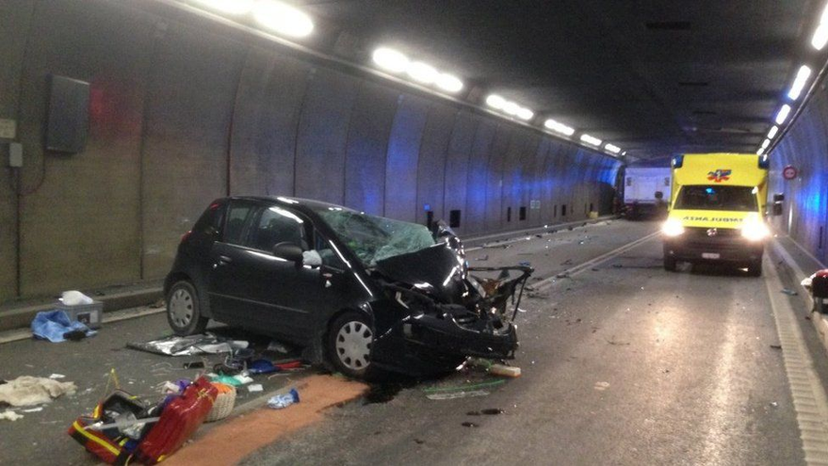
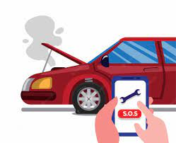
Problem statments
Project idea

Slide 6
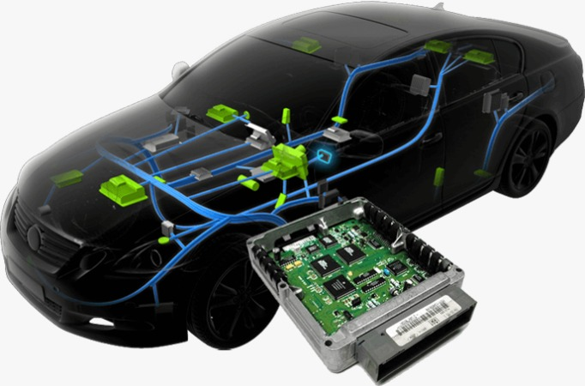
TELEMATICS CONTROL UNIT

Slide 7
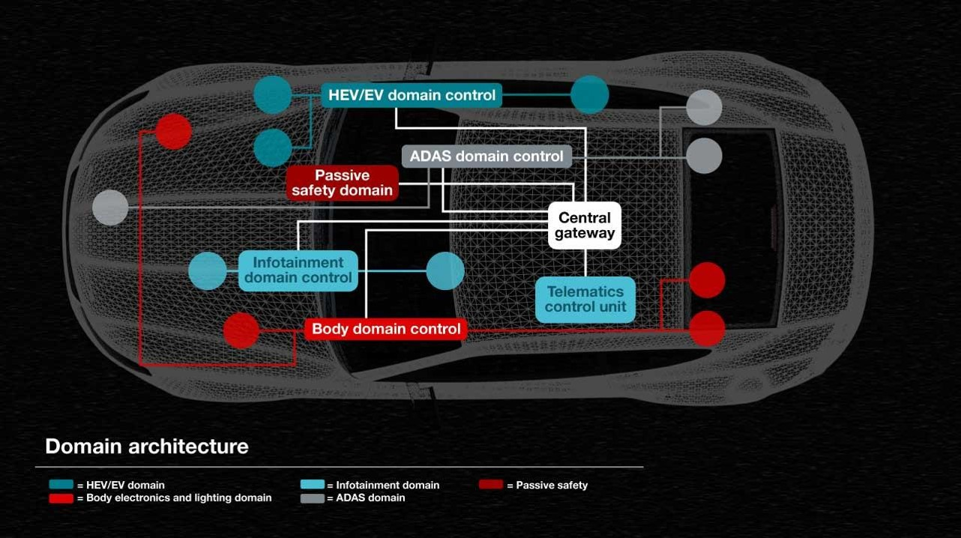
CLASSICAL VEHICLES

Slide 8
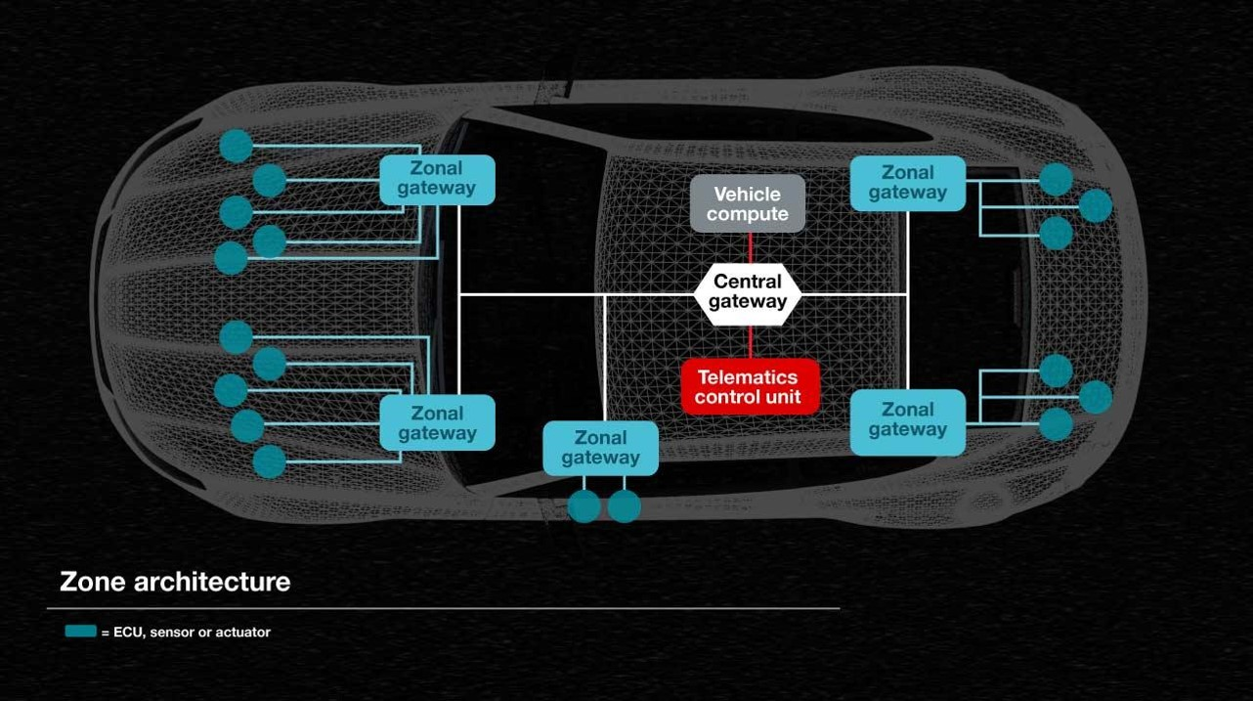
MODERN VEHICLES

Slide 9
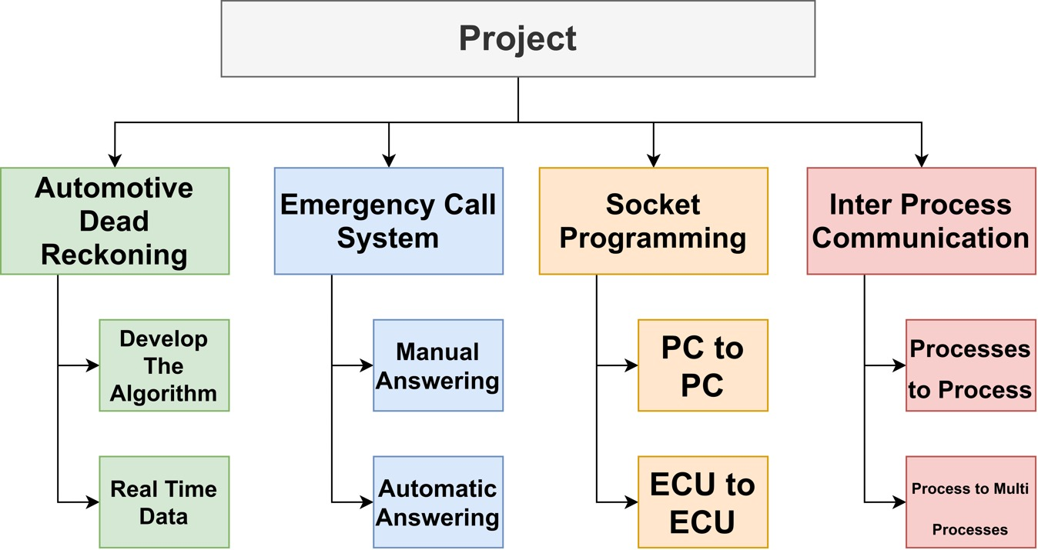
WORK BREAKDOWN STRUCTURE

Slide 10
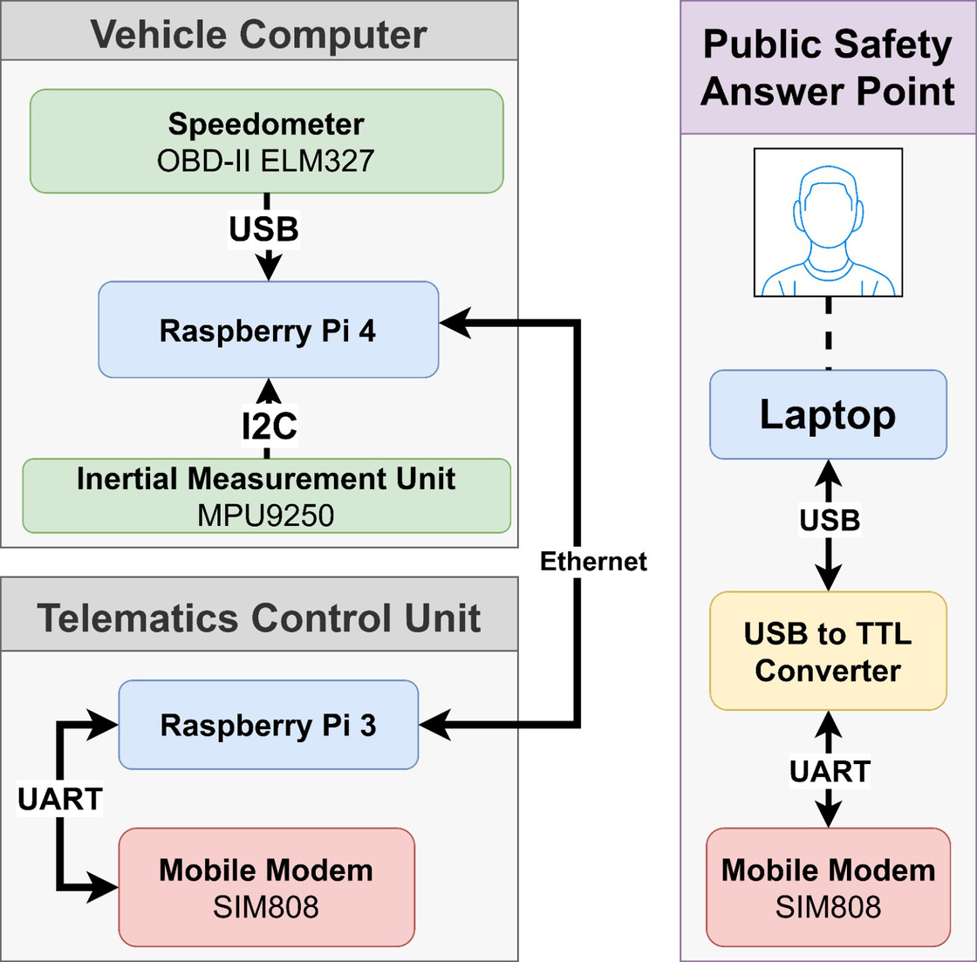
SYSTEM ARCHITECTURE

Slide 11
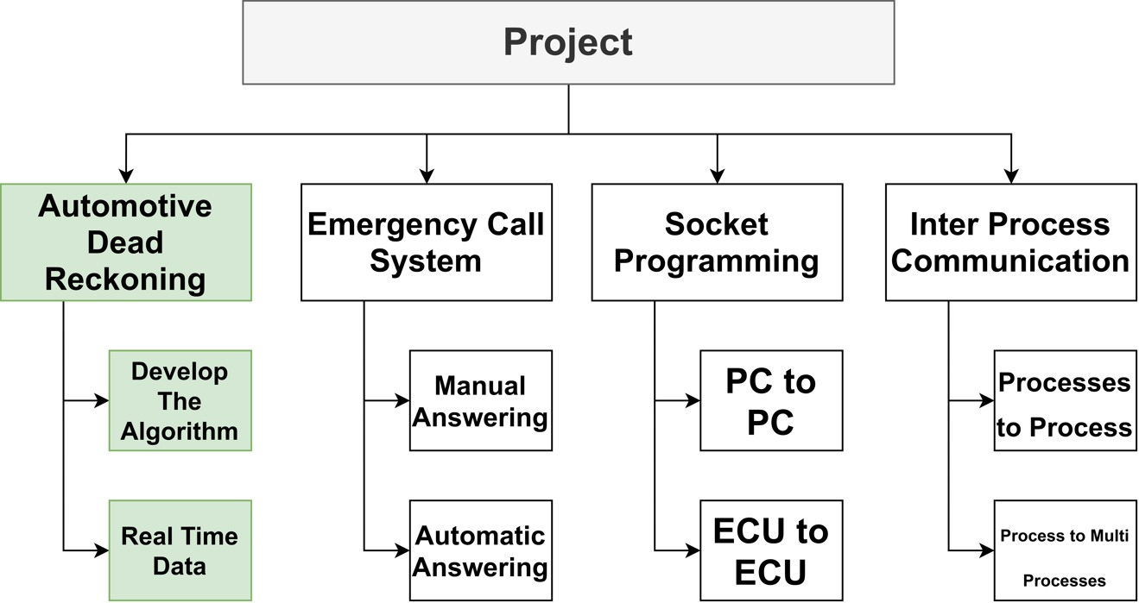
Part 1: Automotive Dead Reckoning

Slide 12
Problem statement
obstruction of GPS signals
inaccurate location information
effectively & quickly respond of emergency services means the difference between life and death.

Slide 13
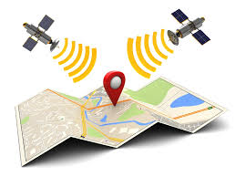
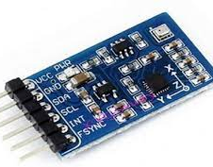
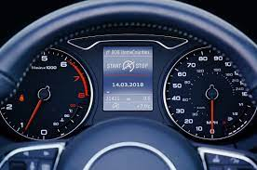
fusing the data
GPS
IMU
SPEEDOMETER

Slide 14
Why use IMU&GPS and Speedometer ?
1
Their error dynamics are completely different and uncorrelated that mean of one of these failed The others are unlikely to fail.
2
IMU and speedometer provides smoothing of the GPS signal and continue to estimate the car state during GPS outage.
3
GPS provides absolute positioning information to reduce IMU drifts.
4
IMU and speedometer provided with the proper vehicle’s motion dynamics into the information fusion process can provide a good estimation of the car’s position during GPS outage

Slide 15
Why use ES-KF
Better performance compared to vanilla EKF
less computation compared to UKF+
Easy to Work with rotational quantities like Quaternion

Slide 16
ES-EKF coupling
lossy coupled sensor fusion approach
why a loosely coupled?

Slide 17
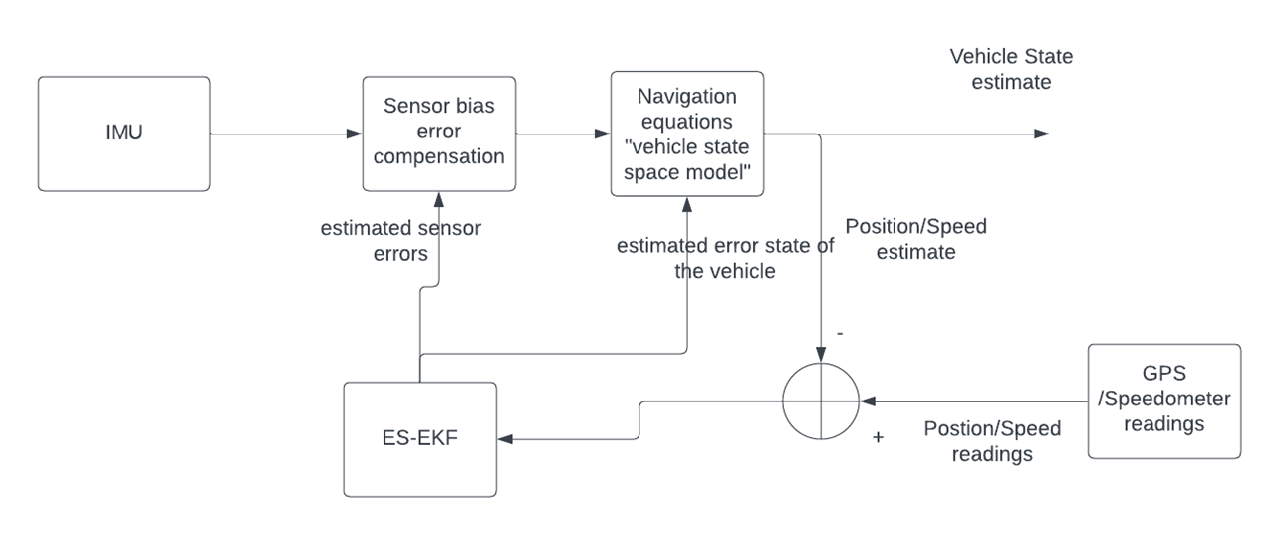
Proposed algorithm for GPS outage

Slide 18
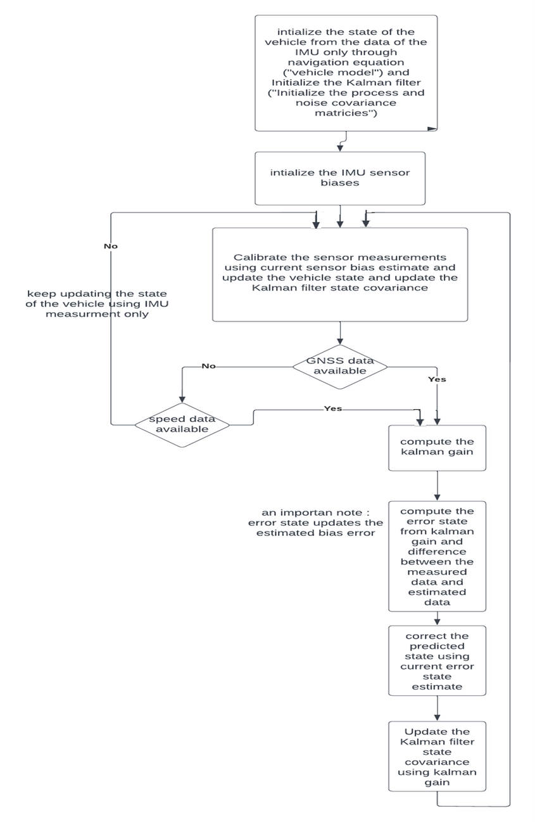

Algorithm flow graph

Slide 19
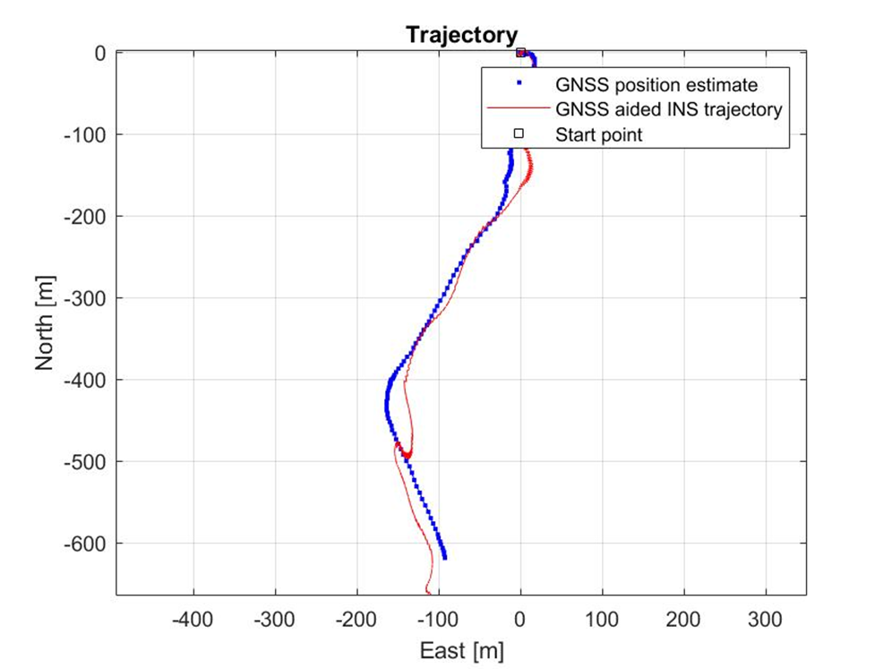
output of the algorithm from collected data from mobile IMU "100HZ",GPS"1HZ", Speed"1hz"

Slide 20
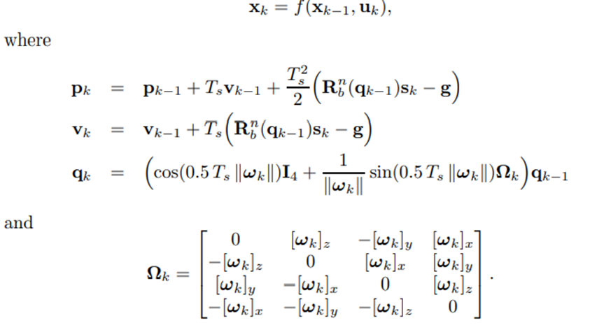
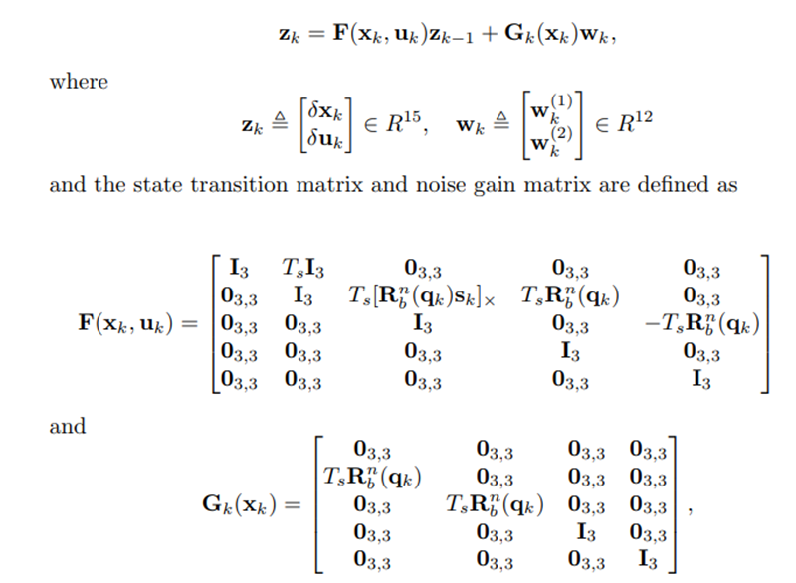
IMPORTANT MATH EQUATIONS
https://www.iri.upc.edu/people/jsola/JoanSola/objectes/notes/kinematics.pdf

Slide 21
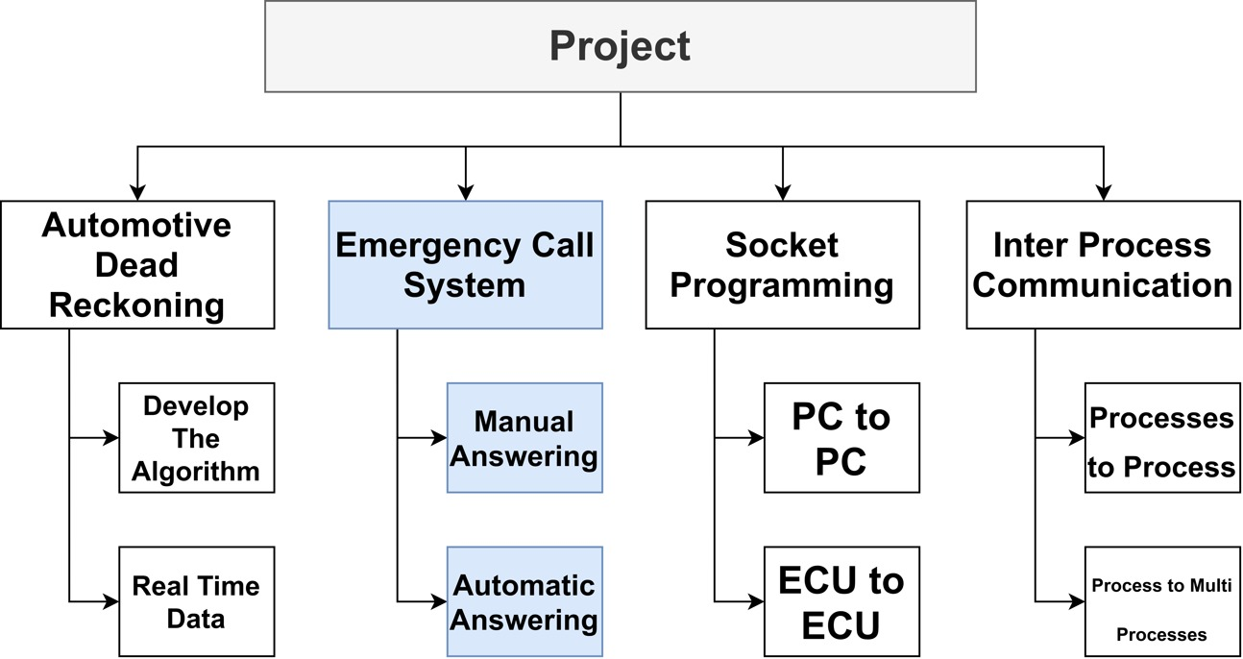
Part 2: Emergency Call System

Slide 22
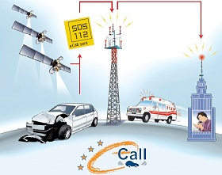
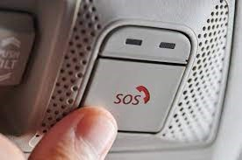
ECALL & BCALL
ECALL
BCALL
If your vehicle is involved in a serious accident, you will be connected with the nearest emergency
response
network.
It allows drivers to call for 24-hour roadside assistance in the event that the car breaks down or in case of the need of
help.

Slide 23
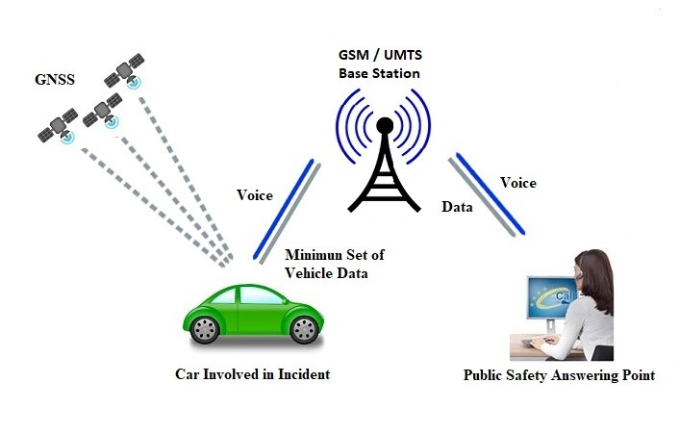
ECALL & BCALL
https://www.researchgate.net/publication/267865585_ECall_minimum_set_of_data_transmission_-_Results_from_a_field_test_in_Finland

Slide 24
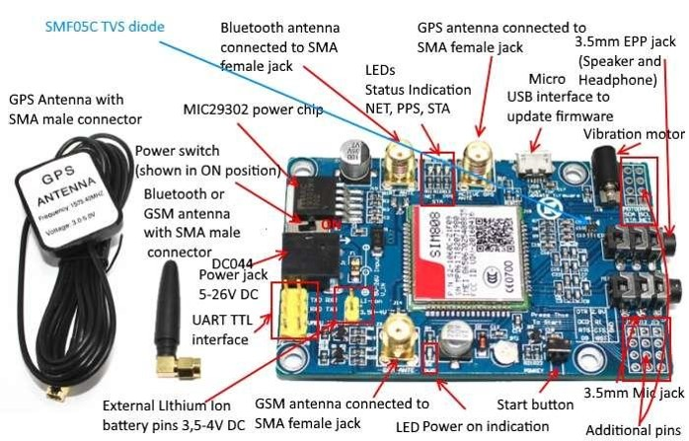
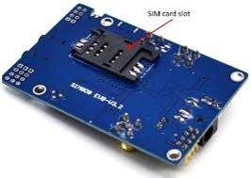
hardware used for ECALL
SIM808
GPS
GSM
GPRS
Controlled by AT commands

Slide 25
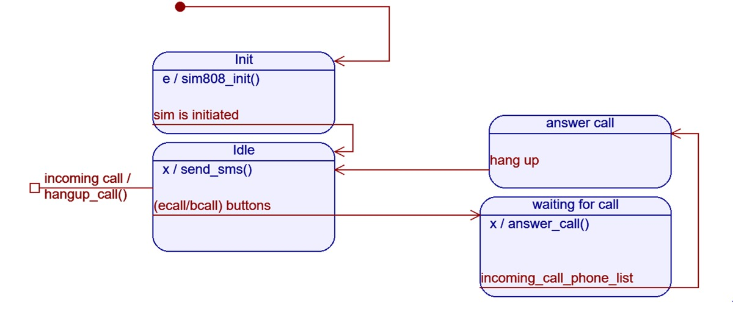
STATE MACHINE

Slide 26
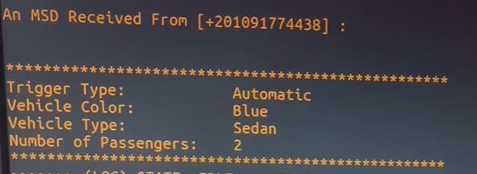
sending MSD
MINIMUM SETUP DATA
•Vehicle registration
•Vehicle type
•Propulsion type
•Position data
•Time of the incident
•Trigger type
•Position confidence

Slide 27
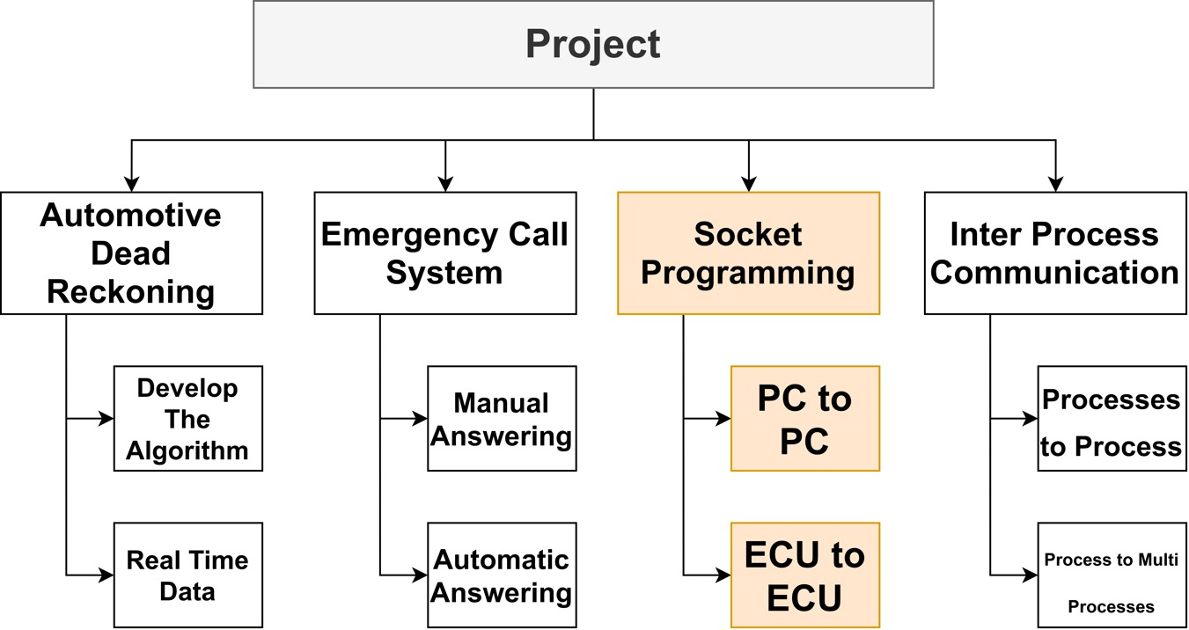
Part 3: Socket Programming

Slide 28
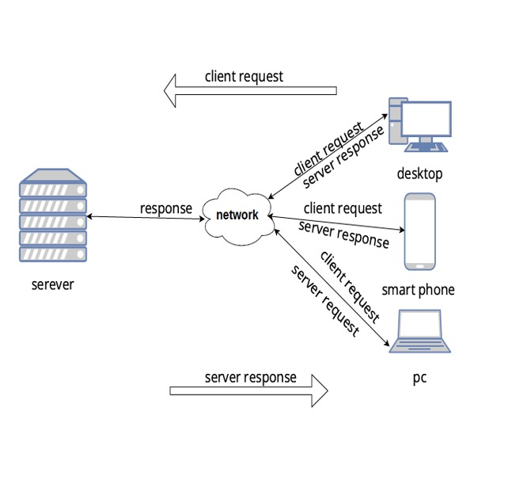
Part 3: Socket Programming
1
DEFINITION
Is a method to connect two nodes over a network to establish a means of communication between those two nodes.
A node represents a computer or a phys_
ical device with an internet connection.
A socket is the endpoint used for
connecting to a node.
2
IDENTIFICATION
IP address & Port number
3
EXAMPLE
communicate between two raspberry PIs

Slide 29
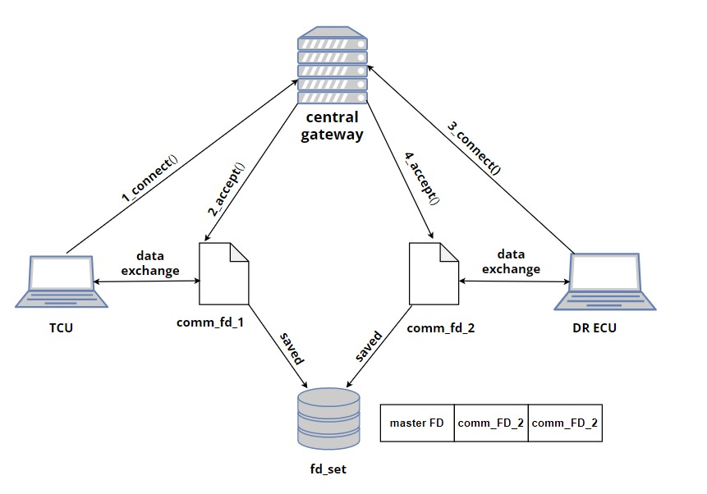
connection between TCU ECU&gateway ECU

Slide 30
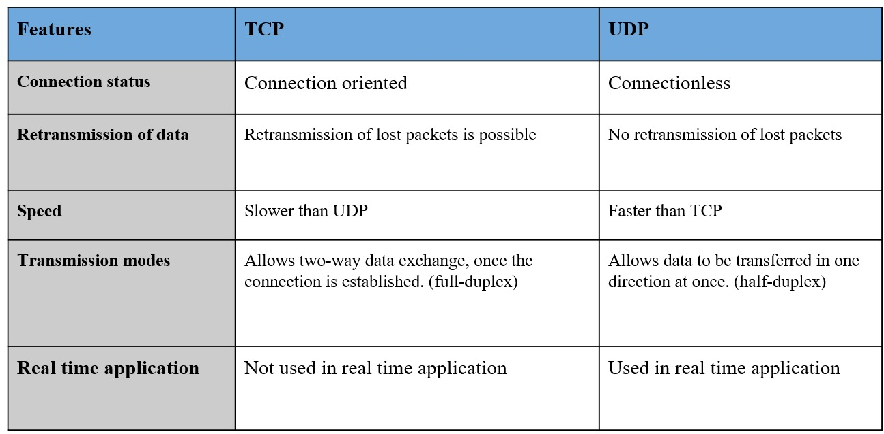
TCP VS UDP

Slide 31
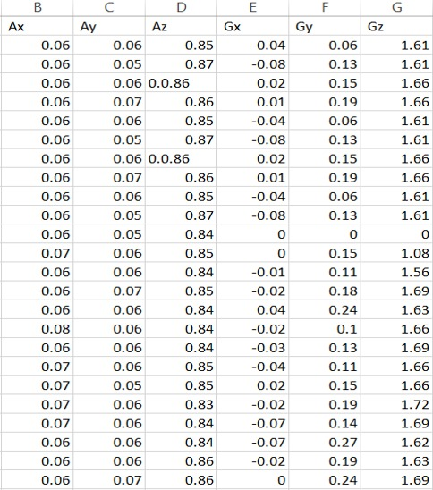
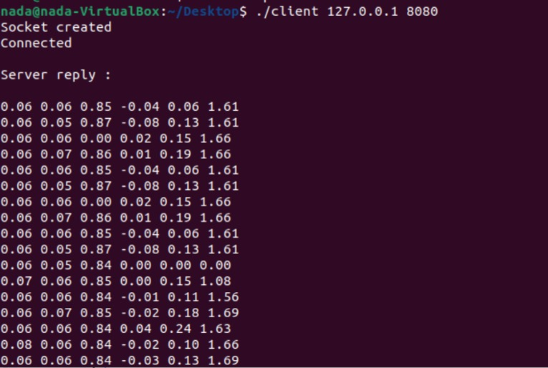
sending sensor data between two raspberry pi
The sensor readings client side receiving data

Slide 32
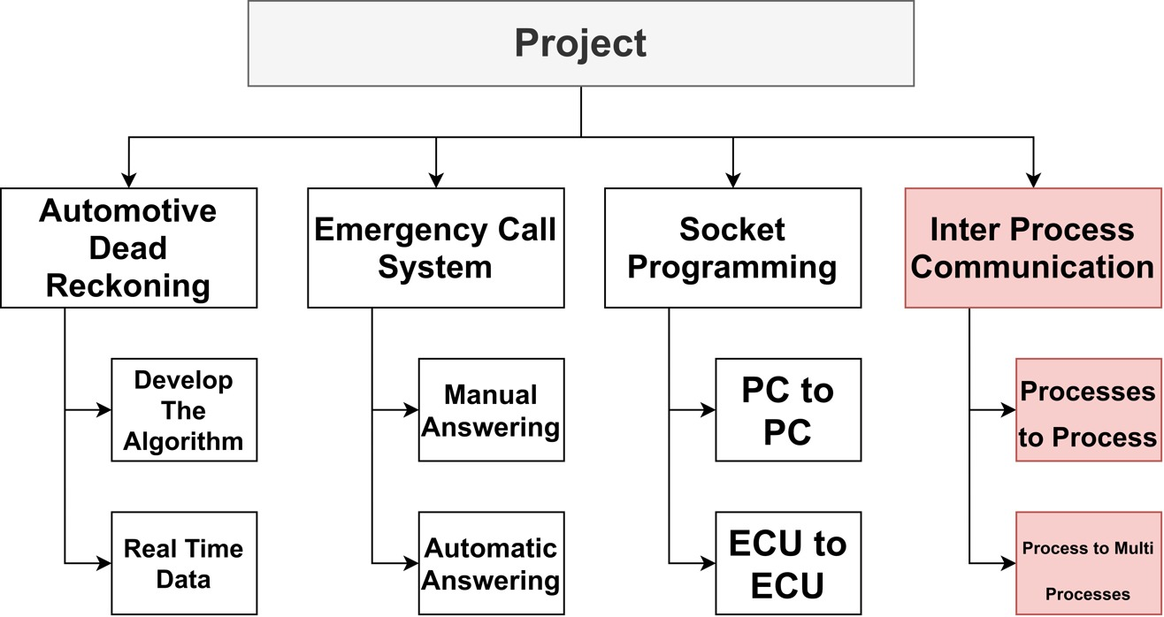
Part 4: Inter-Process Communication

Slide 33
WHY LINUX FOR TELEMATICS
Re-use & Features Extendibility
cost
Time to market
Full control

Slide 34
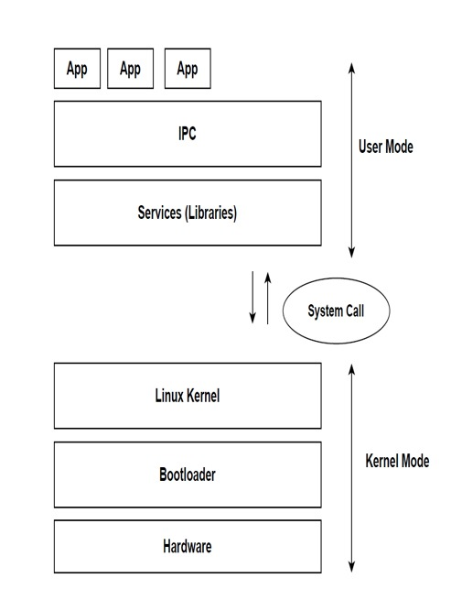
Generic Architecture for Embedded Linux
●Bootloader is the first piece of
code running by the processor.
●Linux kernel provides subsystems to manage all SW/HW resources.
●User space can communicate with kernel by system call.

Slide 35
IPC
Linux runs processes /applications at the same time
Processes running on the same machine need to exchange data with each others
Linux provides IPC mechanisms for processes running on the same machine

Slide 36
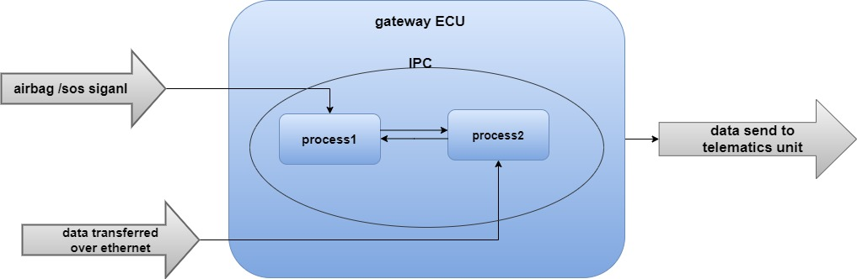
IPC in our project

Slide 37
Project's Demo

Slide 38
Thank you

